Slide 1
Object Oriented Analysis & Design (OOAD)
Elaboration-Iteration 1
Chapter 8

Slide 2
Iteration 1, Elaboration:
uses many OOA/D skills
should be architecture-centric (big picture) and risk-driven
early iterations don't do the whole Use Case.
more Requirements Analysis to come; helped by feedback

Slide 3
NextGen POS 1st Iteration Requirements
Implement a basic, key scenario from the Process Sale use case: enter item, receive cash
Implement start up use case
Nothing fancy or complex, “happy” scenario only; not the whole Use Case
No collaboration with external services like tax
No complex pricing rules.
Subsequent iterations grow on this foundation

Slide 4
What we do in this Iteration:
Iteration 1 requirements are subsets of complete requirements; e.g. cash sales only
We build production-quality, tested code for a subset of requirements
We start development without a complete requirements analysis

Slide 5
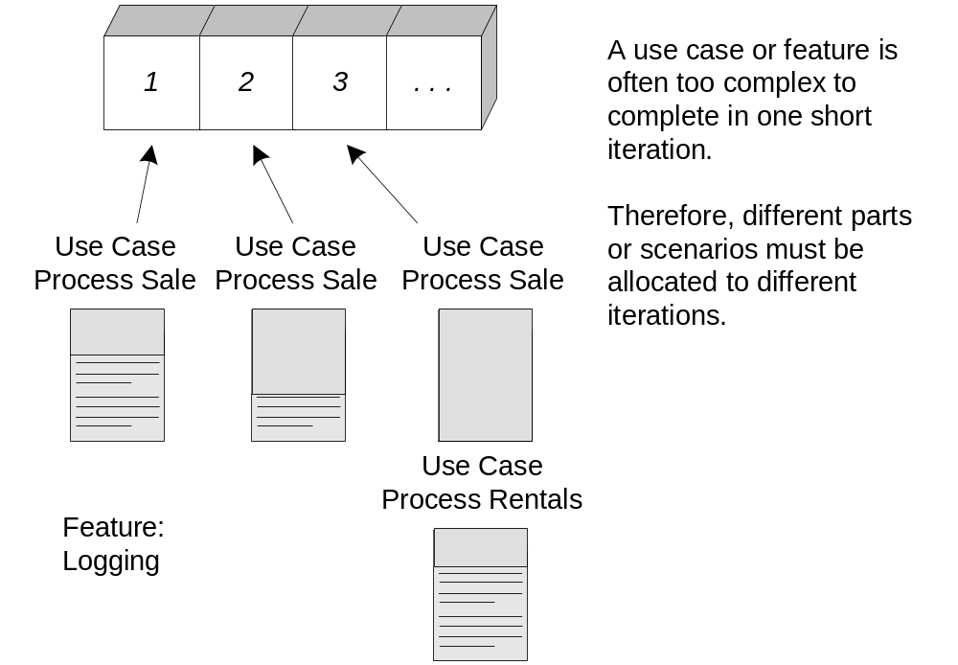
Fig. 8.1
complete
incomplete

Slide 6
What we did in Inception…
At Inception we used only a week and determined basic feasibility, risk and scope. Activities were
  short requirements workshop
  most actors, goals and use cases named
  most use cases in brief format; 10% fully dressed
  risks identified and listed
  UI prototypes looked at
  what to buy, what to build
  plan for 1st iteration
  tools list

Slide 7
What we will do in Elaboration…
At Elaboration we move on to a series of iterations. Activities are:
  core, risky software is coded and tested
  majority of requirements are discovered
  major risks mitigated
  short time-boxed iterations
  program early
  adaptively design, code and test the core
  test early
  adapt based on feedback
  write most of the use cases
NOTE: “Risk” includes business value

Slide 8
Planning the Next Iteration:
Project planning is a big topic in standard software engineering courses. It is less important in this course.
For us, we will try to organize ourselves around the three topics – risk, coverage and criticality
  risk: complexity, unknown effort or usability
  coverage: are all major parts at least touched on? Should be “wide and shallow”.
  criticality: things of high business value e.g.
these issues revisited at the end of each iteration; perhaps they need adaptive thinking too

Slide 9
Domain Modeling

Slide 10
Domain Modeling
After you have your requirements you start modeling the domain.
You are still modeling the business, not the program classes.
Various influences:
  Source of info is the use-cases
  operational contracts (like pre- and post-conditions)
  conceptual classes give us ideas for what to name our program classes

Slide 11
Example:
The following (next slide) are the conceptual classes for Payment and Sale.
Part of the Conceptual Perspective
Don’t be too thorough; avoid waterfall.

Slide 12
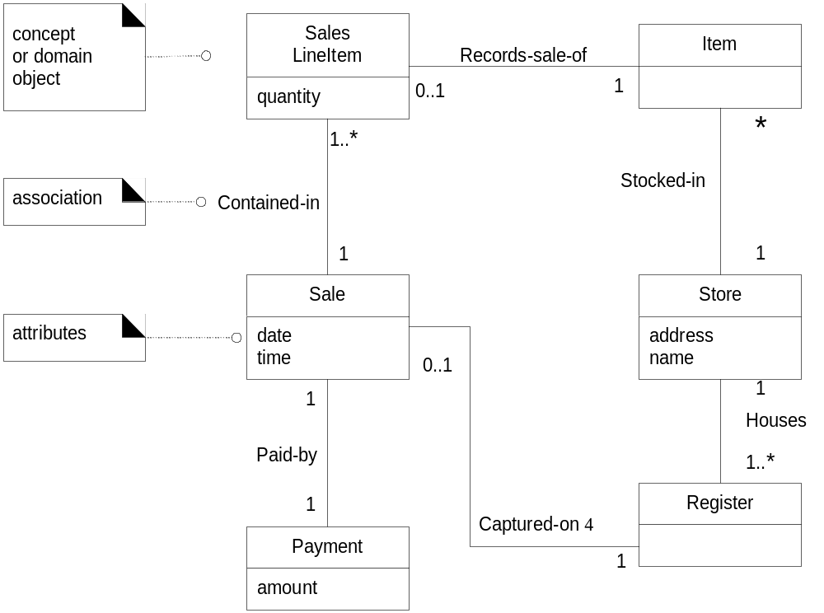
Fig. 9.2
NOTE: The direction
of references.

Slide 13
Domain Model (DM)
Decompose the domain into noteworthy concepts and/or objects.
The DM is a visual representation of real-situation objects and conceptual classes.
Sometimes called Conceptual Model.
In UP, this is one of the Business Modeling artifacts.
Specifically, a class diagram with no operations or behavior.
DM Shows:
  Domain objects e.g. Sale
  Associations e.g. PaidBy
  Attributes e.g. date, time etc

Slide 14
What not to include:
Software artifacts like salesDatabase, databases, windows
Responsibilities (i.e, methods)

Slide 15
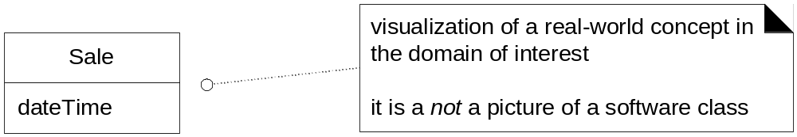
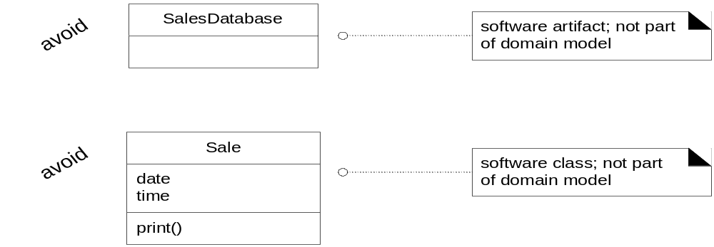
Fig. 9.3

Slide 16
Where does it fit?
The Domain Model feeds into just one part of a program’s design.
Typical program uses the MVC (Model-View-Controller) paradigm; the DM feeds the Model part only.
The author uses the term “domain layer” to mean the software components that underlie the UI layer.
We consider a conceptual class from 3 points of view
  symbol: what words we use to name it e.g. Sale
  intension: its complete definition
  extension: a set of examples of the class i.e. objects of Sale

Slide 17
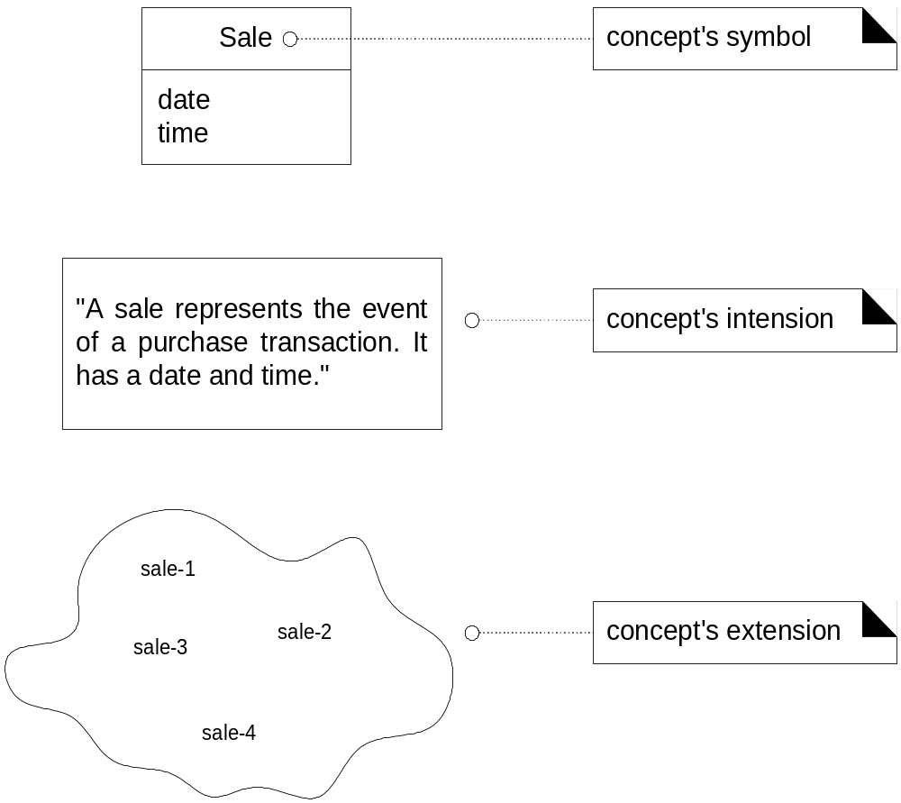
Fig. 9.5

Slide 18
Are Domain and Data Models the same?
A Data Model is a model of persistent data; i.e. data in a database or file system.
Unlike a Data Model, just because we may never build the class, doesn’t mean we don’t put it in a Domain Model.
Some Domain Model classes are purely behavioural

Slide 19
Why Build a Domain Model?
The developer has to understand the business so that is a good reason to build the Domain Model
We want to use software artifact names that “remind” us of what real-world things they model. So it is a good idea to list those domain concepts (visually).

Slide 20
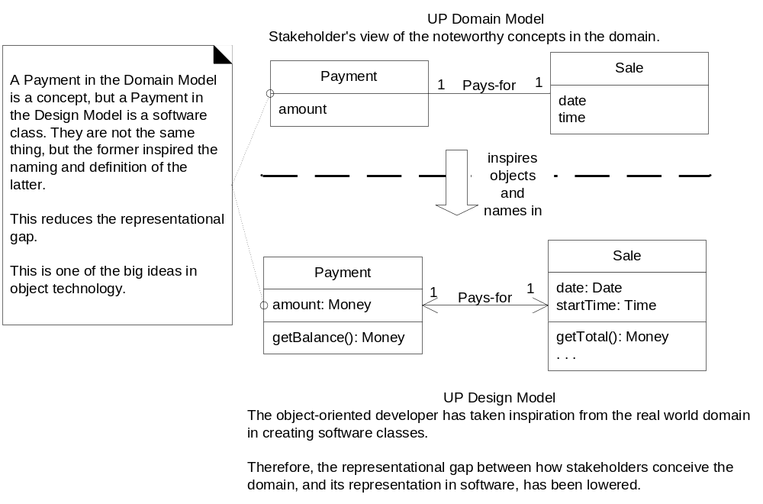
Fig. 9.6

Slide 21
How to Identify Classes (Guidelines)?
Limit yourself to the interests of the current iteration; don’t try to draw the entire Domain Model up front (waterfall).
To decide what classes to use, look around at what other developers have done here or in this area of endeavour (We will see this when we discuss software design patterns).
Make Lists
Linguistic Analysis

Slide 22
List of Categories and possible classes
Conceptual Class Category Examples
Business Transactions | Sale, Payment, Reservation
Transaction Line Items | SalesLineItem
Products or Services | Item, Flight, Seat, Meal
Where Transaction Recorded | Register, Ledger, Manifest
People’s Roles | Cashier, Customer, Passenger
Place of Transaction | Store, Airport, Plane, Seat
Noteworthy Events | Sale, Payment, Flight
Physical Objects | Item, Register, Board, Airplane
Descriptions of Things | ProductDescription, FlightDescription

Slide 23
List of Categories and possible classes
Conceptual Class Category Examples
Catalogs | ProductCatalog, FlightCatalog
Containers for Things | Store, Bin, Airplane
Things in Containers | Item, Square (on a Board), Passenger
Other Systems | CreditAuthSystem, AirTrafficControl
Records of Finance, Work | Receipt, Ledger, MaintenanceLog
Financial Instruments | Cash, Check, LineOfCredit,TicketCredit
Schedules, Manuals, Docs | DailyPriceChangeList, RepairSchedule

Slide 24
Linguistic Analysis:
Identify the nouns and verbs in text descriptions like a text-based Use-Case; consider these as candidate conceptual classes.

Slide 25
Fully Dressed Use Case (1):
Scope: NextGenPOSApplication
Level: User Goal
PrimaryActor: Cashier
StakeholdersAndInterests:
  cashier wants: …
  customer wants: …
  company wants: …
  manager wants: …
  government wants: …
  CC company wants: …

Slide 26
Fully Dressed Use Case (2):
Preconditions: Cashier identified and authenticated
Postcondtions: Sale completed, tax calculated, inventory updated, commission recorded, cc approval recorded
MainSuccessScenario:
  Customer arrives with goods
  Cashier starts new sale
  Cashier enters item identifier
  Systems records sale and presents description and running total
  (repeat 3-4 many times)
  System presents total
  …

Slide 27
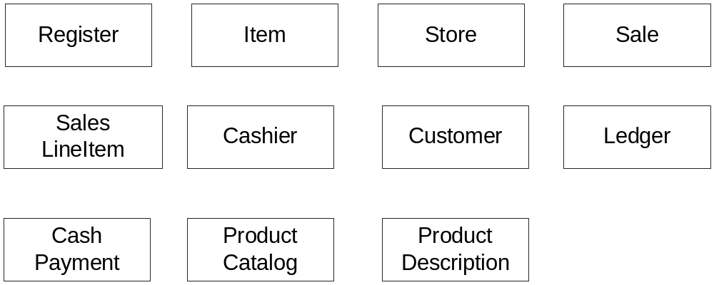
Identified Conceptual Classes

Slide 28
What about Using a Tool?
There is little motivation to update a model unless it is easy to do so.
That is why the author likes the whiteboard.
The practical reason for updating is to keep the model as a documentation tool (for version 2).

Slide 29
Attributes vs Classes:
A common mistake is to cross identify these things.
Rule of Thumb 1: If you don’t think of something as a number or string in the real world, it probably is a class.
Rule of Thumb 2: Classes are capable of independent existence; attributes are properties of things.

Slide 30
Examples:
Sale
store
or?
Sale
Store
phone
Flight
destination
or?
Flight
Airport
name

Slide 31
When to Model Descriptions?
A description class describes something else.
The difference between an object and a description of it is like the difference between a copy of a book and a book itself. If you run out of copies you may still need to know about the book.
Intension vs Extension
Physical Object vs Type of Thing
So we need an Item class and a ProductDescription.
How do you tell them apart? Identify their keys or identifying attributes.

Slide 32
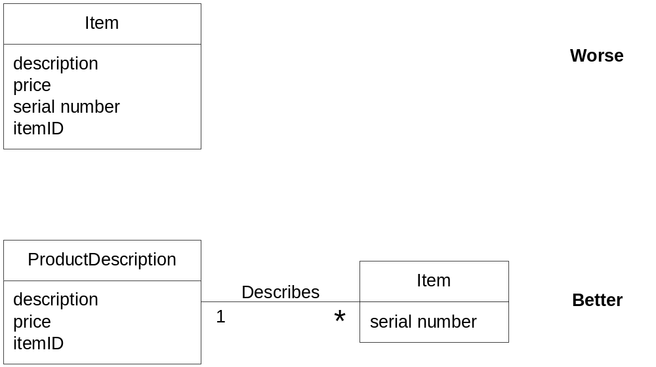
Fig. 9.9
Book
Copy

Slide 33
Associations:
A relationship between classes (or instances of classes).
When do we show them?
  when we need (real-world) to remember the other to fulfill client requirements…
Do we need to record what SaleLineItem instances are associated with a Sale instance….?
Too many associations make for an unwieldy (difficult to handle) diagram
What associations are “implemented”?
  Not all
  some new ones appear between software objects

Slide 34
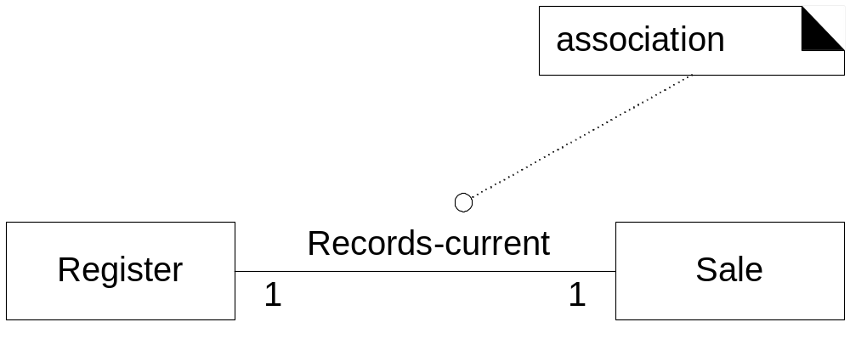
Association Example

Slide 35
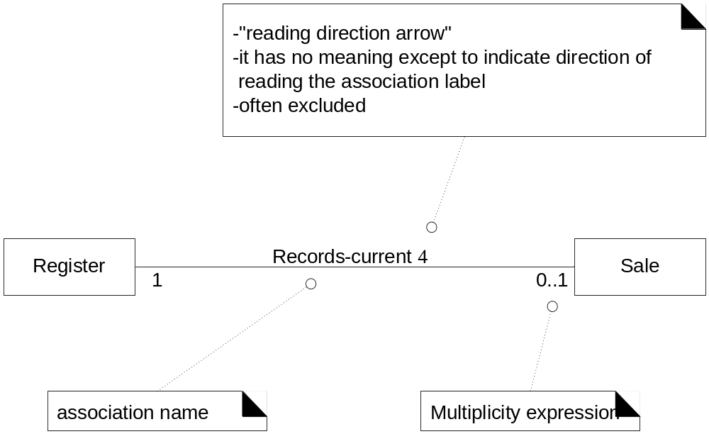
The UML Notation for Associations
NOTE: Not over time!!
How many instances of Sale can be associated
with an instance of Register? Ans: 0 or 1

Slide 36
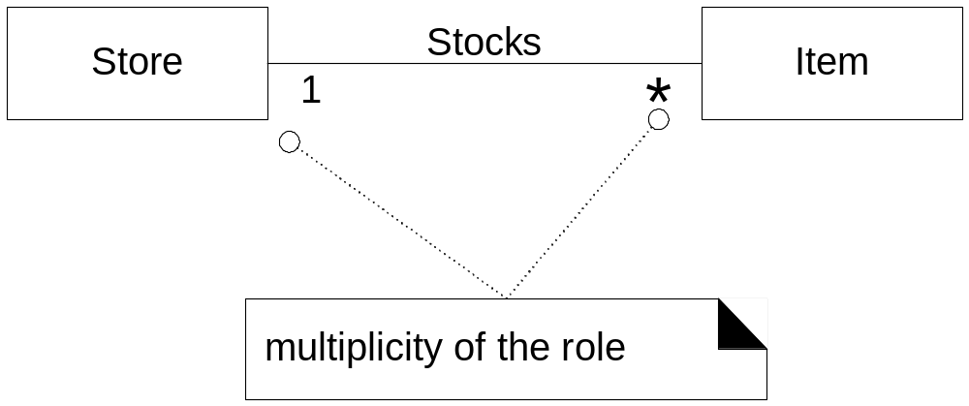
UML Roles
Many instances of item
with the same store

Slide 37
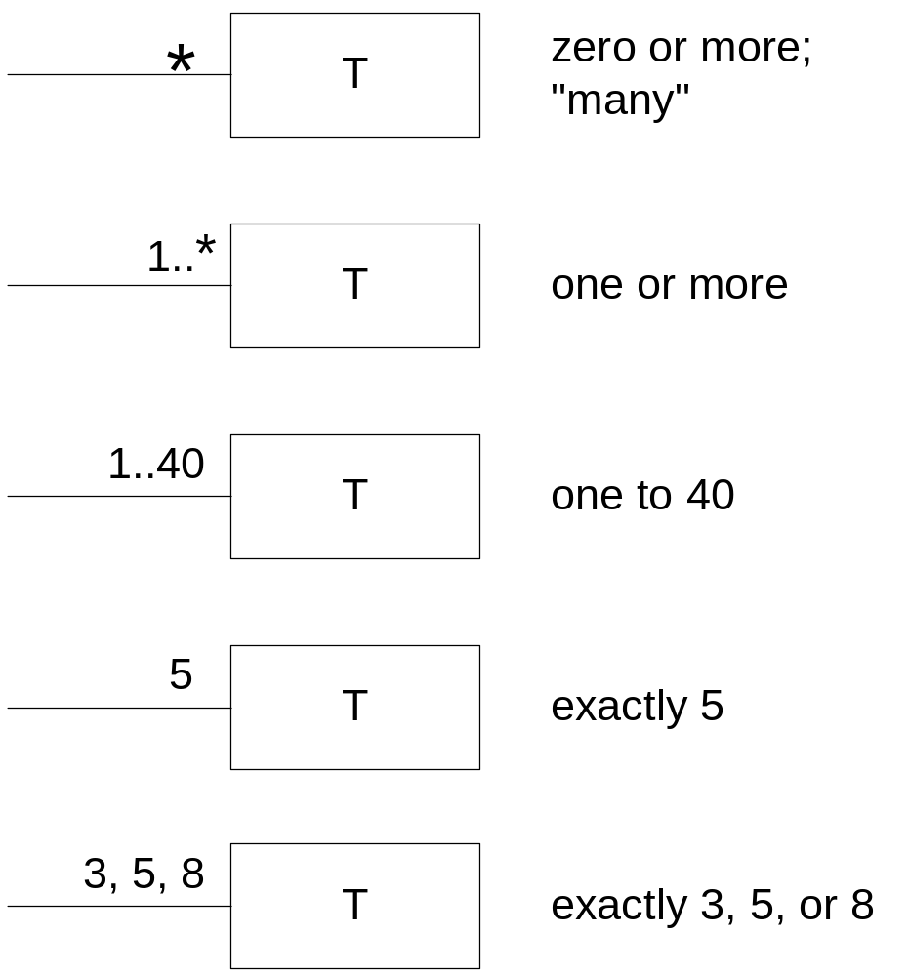
Multiplicity Values
Multiplicity values reflecting domain constraints

Slide 38
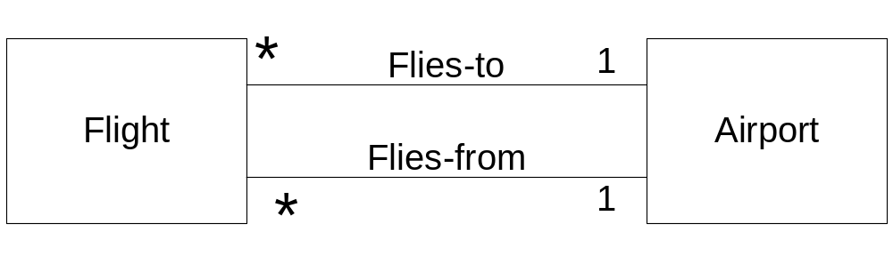
Multiple Associations

Slide 39
Where to Start Adding Associations:
A is a transaction related to another transaction B | Payment - Sale
A is a line item of a transaction B | SalesLineItem - Sale
A is a product or service for a transaction (or line item) B | Item - SalesLineItem
A is a role related to a transaction B | Customer - Payment
A is a physical or logical part of B | Drawer - Register
A is physically or logically contained in B | Register - Store
A is a description of B | ProductDescription - Item
A is known/logged/captured in B | Sale - Register
A is a member of B | Cashier - Department
A is an organizational subunit of B | Department - Store
A uses or manages or owns B | Cashier - Register
A is next to B | SalesLineItem - SalesLineItem

Slide 40
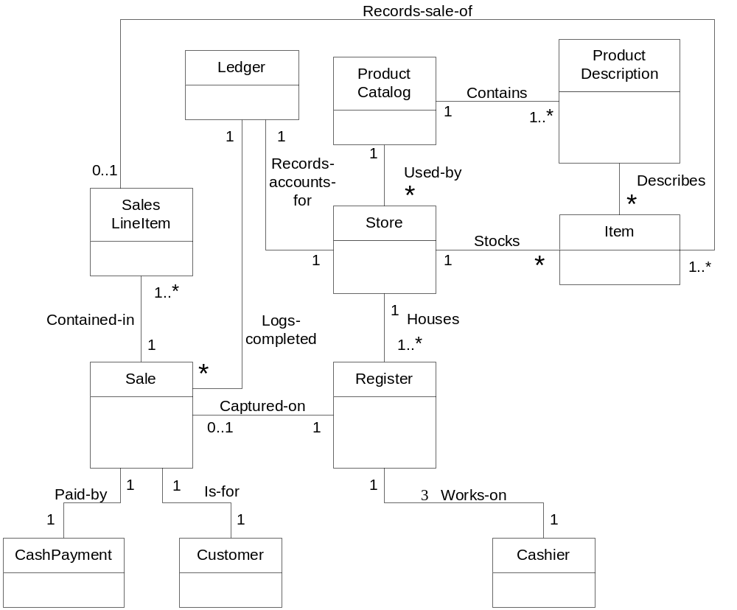
POS Partial Domain Model with Associations

Slide 41
Attributes:
An attribute is a logical data value of an object.
Find them in the text analysis of the requirements
Show in DM when requirements suggest a need to remember information e.g. a receipt (which prints info related to Sale) in the Process Sale use case need to include Date, Time, StoreName, Address among many other things.

Slide 42
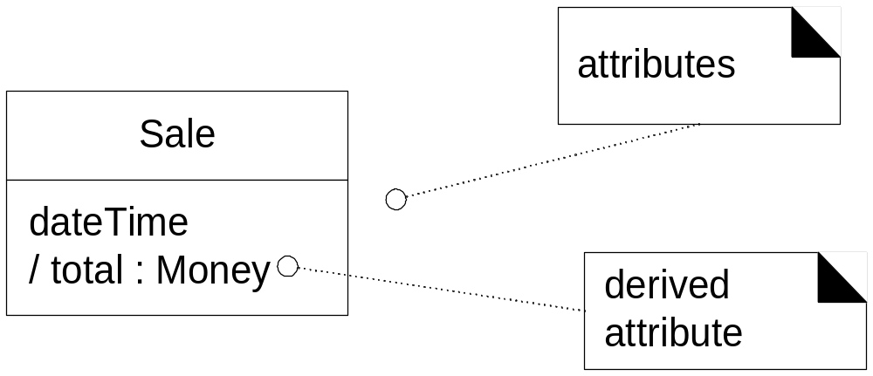
Class & Attributes
derived

Slide 43
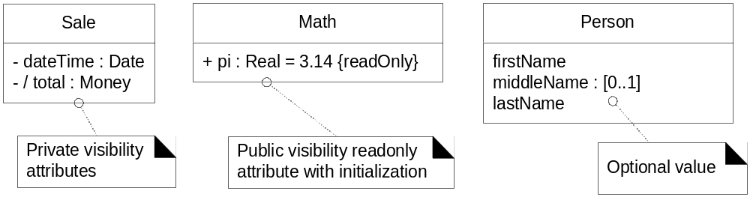
Attribute Notation in UML
NOTE: You can “invent” obvious data types on your own

Slide 44
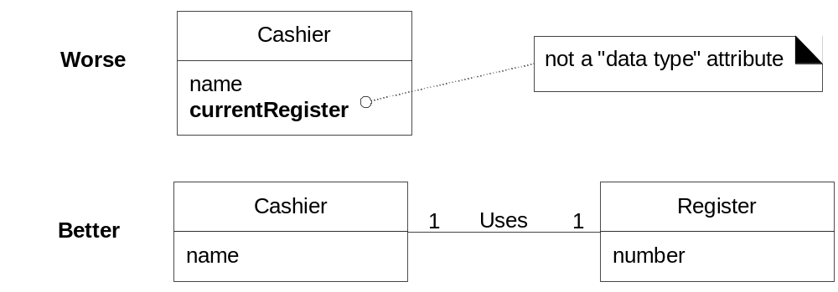
Don’t Show Complex things as attributes
Register is a complex thing

Slide 45
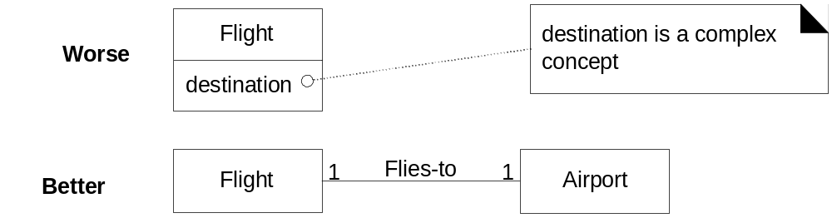
Contd…

Slide 46
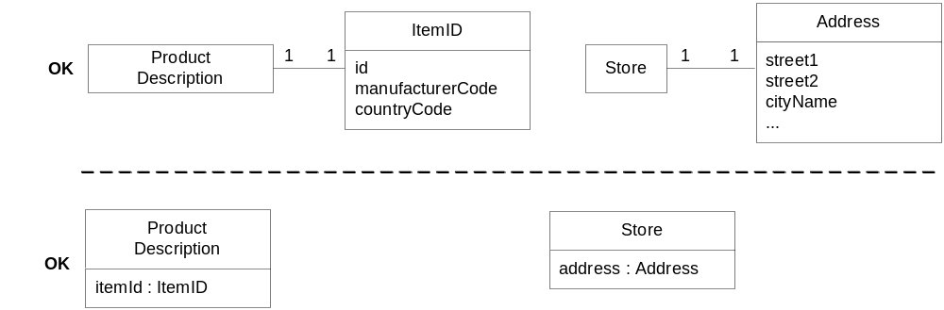
Fig. 9.24
Might need Addresses for a
delivery schedule
Never gets shown as a class because it has not complexity
other than the fact that it is a code.

Slide 47
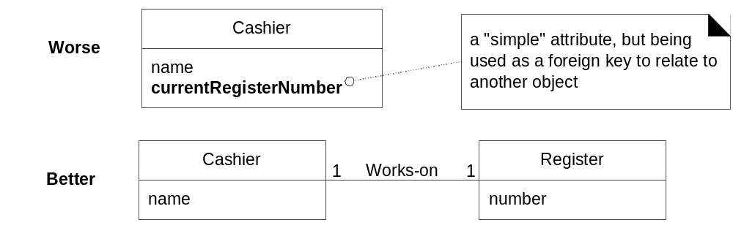
Fig. 9.25
Don’t use attributes to represent associations in
the Domain Model (i.e. foreign key syndrome)

Slide 48
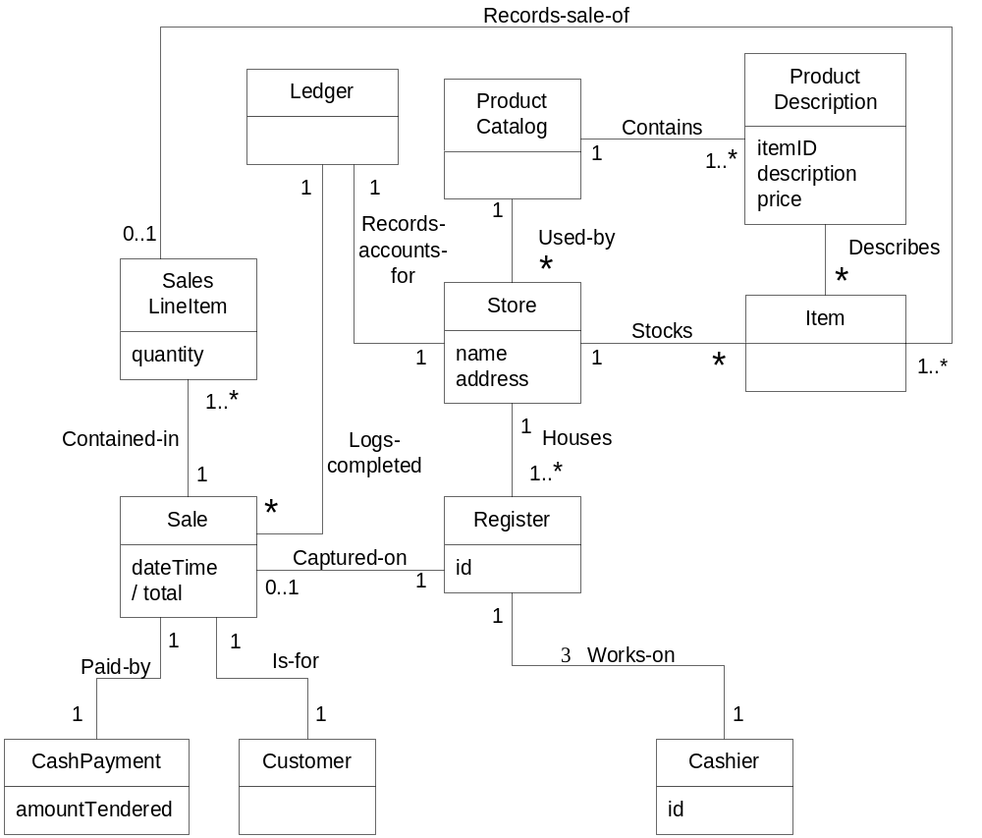
Partial Domain Model with Attributes

